Slide 1

Review Writing: Wonder
LO: To consider the features of a review and my thoughts on Wonder as a novel.
Starter
On your post-it note, write the following about Wonder:
WWW
What is something you really enjoyed about the novel? Think about its structure, characters, language, plot line, themes etc…
EBI
What s something you were less keen on? Did it make you feel a certain way? Were there any parts you felt dragged? Why?
An overall score out of 10.
FC: What are some features of a review article? List them in your notes.

Slide 2
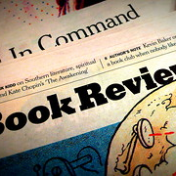
Writing a Review
Discuss with the person sat next to you:
What is the purpose of a book review?
What would you expect a review to contain?
Who might the review be for (in the case of Wonder).
What kind of language would you expect a review to be written in?

Slide 3
Features of a review
Target Audience:
Potential readers! In the case of Wonder, more likely to be for children.
Potentially for parents! If written by an adult, it may also inform parents about the benefits/drawbacks of buying this novel for their children.
Purpose:
To express opinion and inform potential readers about the book’s quality.
Features:
Opinion + evidence (I thought the novel was scary because…)
A brief overview of the story (without spoilers)
Comment on the book’s main features: structure, quality of writing, characters, themes and morals from the story.
Kind of language :
Dependent on target audience: if for children, more simplistic.
Use of first person to express opinion.
A balance of formal and informal language.

Slide 4
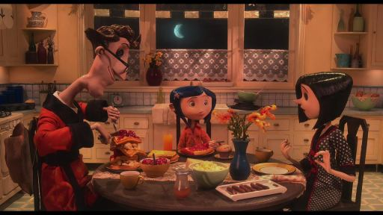
Example Review
Read through the book review of Coraline. Consider the following questions as you go:
Where do we see the typical features of reviews in this example?
What is the structure of the review? Put a title for each of the paragraphs to outline what the purpose of each is.
Further Challenge:
Give the article a WWW and EBI.
What makes it a good review? How could it be improved?

Slide 5
Over to you!
An opening sentence to hook the reader & introduce the novel.
Give it a rating out of 10!
A paragraph of overview on the main plot points, characters – introduce the novel & writer. What is the writer’s aim?
Write your review of Wonder, following the features of a typical review.
Consider the following things:
What aspects of the novel did you enjoy and think were of good quality? (Plot, themes, emotions, structure, quality of writing etc.)
Include key quotations or messages from the novel.
If there were any defects, what were they and how did the impact your enjoyment?
If you think the novel was without defects, justify why you think the book was “ideal” or “perfect”!
Target Audience: Children aged 10-14
WWW Paragraph: What did you enjoy? Why do you think the novel is of good quality? Did it achieve its purpose?
EBI Paragraph: Any elements you felt detracted from your enjoyment? Why?
Concluding paragraph: Final comments – should someone buy this book? Why? For whom?

